Slide 1
ARTIZENT · DATA & AI PRACTICE · MICROSOFT FABRIC FEATURED PARTNER
Autonomous Agentic AI
on Microsoft Fabric
Artizent's proposal for Project ELEVATE — governed, conversational analytics for Better Companies
In response to the Better Companies RFP: Autonomous Agentic AI Capabilities on Microsoft Fabric
Prepared for Better Companies LLC · Submitted July 2026 · Confidential

Slide 2
INTRODUCTION
You built the foundation. Now let people talk to it.
Our understanding of what Better Companies is asking for — and why we're the natural partner to deliver it
Project ELEVATE has done the hard part: a working Fabric platform, a governed Gold layer, sixty-plus reports the business actually uses. What's missing is the last step — and it's the one your executives feel every day. A manager shouldn't need to know which dashboard holds the answer. They should just ask.
The RFP ask
Governed from day one
A production agent that answers plain-English (and spoken) questions over your Gold layer — with trends, variance, and predictions built in as reasoning, not canned reports. Delivered in Slack first, because that's where your people already are.
Your three-tier RBAC stays exactly as it is — the agent inherits it, never bypasses it. PII never reaches a prompt unmasked. Every question and answer is logged, auditable, and grounded in your data, with guardrails tested before a single user touches it.
We have fair idea on estate
Cost-aware by design
We have discussed about your Fabric environment at length. Our Discovery phase will validate rather than explore — which is why we can commit to a fixed price and a 16-week path to production.
A routing engine sends each question to the cheapest model that can answer it well. At your stated 500 queries a day, we estimate roughly 2–4 cents per query — with an admin console that shows your team the spend, by model, in real time.
2

Slide 3
OUR UNDERSTANDING OF THE SCOPE
What we will build — and what we deliberately won't
Scope of the Engagement
IN SCOPE — the capability we will put in production
OUT OF SCOPE
Conversational NLQ over the Gold layer — plain-English answers, charts and trend visuals when asked
Trend & variance analytics — month-over-month, quarter-over-quarter, year-over-year — computed live, not pre-built
Predictive models trained on your Gold history — forward-looking answers, clearly labeled as predictions
Agent, customer/account, and team analytics for the three personas — deals signed, resolution rate, first payment rate and more
Three-tier RBAC (Agent / Manager / Executive) preserved and enforced on every interaction
Slack as the primary channel, plus a GPT-style chat client and a lightweight admin console
Voice in and voice out — a real spoken conversation, not voice-to-text bolted on
Model-agnostic, cost-aware routing with token-threshold rules and manual overrides
Discovery hardening: data dictionary refinement, dataset grouping, Power BI reverse engineering, and the 20–50 question bank as the QA baseline
External / macroeconomic data feeds
NetSuite and ERP financials (not yet in Gold)
Unstructured data sources
Net-new Power BI reports — existing reports are reused and reverse-engineered, not rebuilt
Changes to the core Fabric platform
3

Slide 4

PROPOSED SOLUTION AND AI APPROACH
Six capabilities that reason over live Gold layer data
1
Conversational NLQ
2
Trend and Variance
3
Predictive Modeling
Plain-English questions return governed answers from the Gold layer, with charts on request.
The agent computes month, quarter, and year comparisons over live data.
Models trained on Gold layer history return forward-looking scores alongside results.
4
Voice Interface
5
Slack Delivery
6
Model Routing
The agent captures voice input and returns spoken answers.
Answers are shared in Slack, so learning compounds across users.
The router selects between LLMs and Copilot by query type, token, and cost.
4

Slide 5
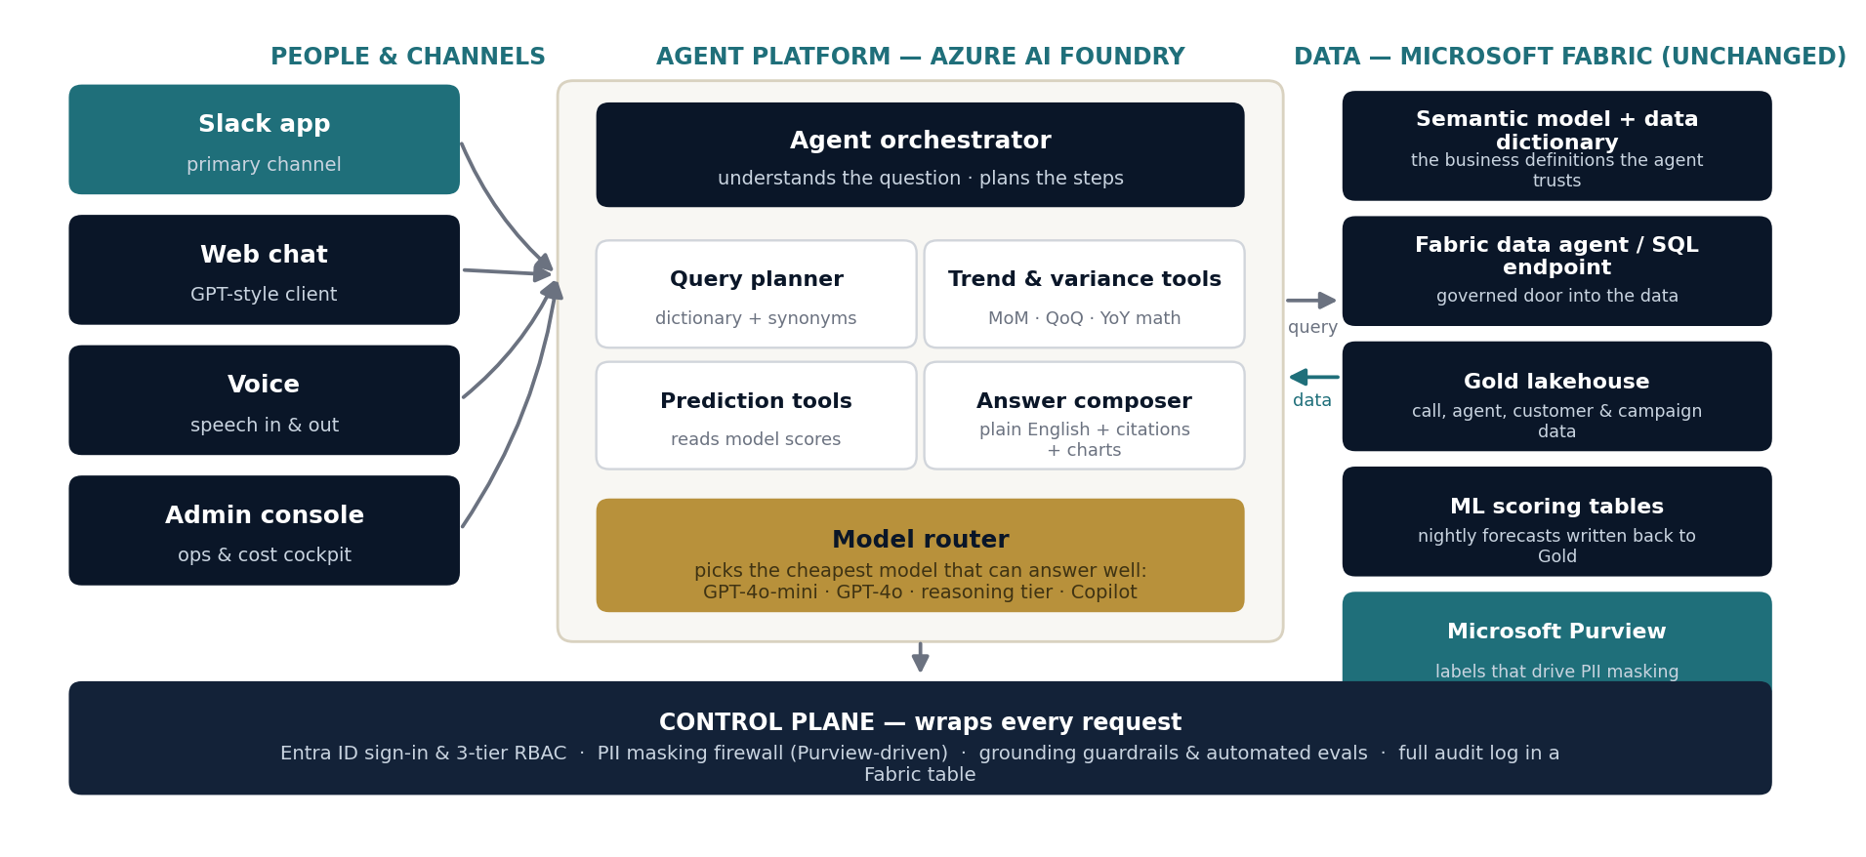
TECHNICAL ARCHITECTURE
The architecture: one governed agent, three clean layers
Channels on the left, intelligence in the middle, your Fabric estate on the right — untouched
5
Everything reads from Fabric; nothing changes Fabric. The control plane wraps every request — identity, masking, guardrails, audit — no matter which doorway the question came through.

Slide 6
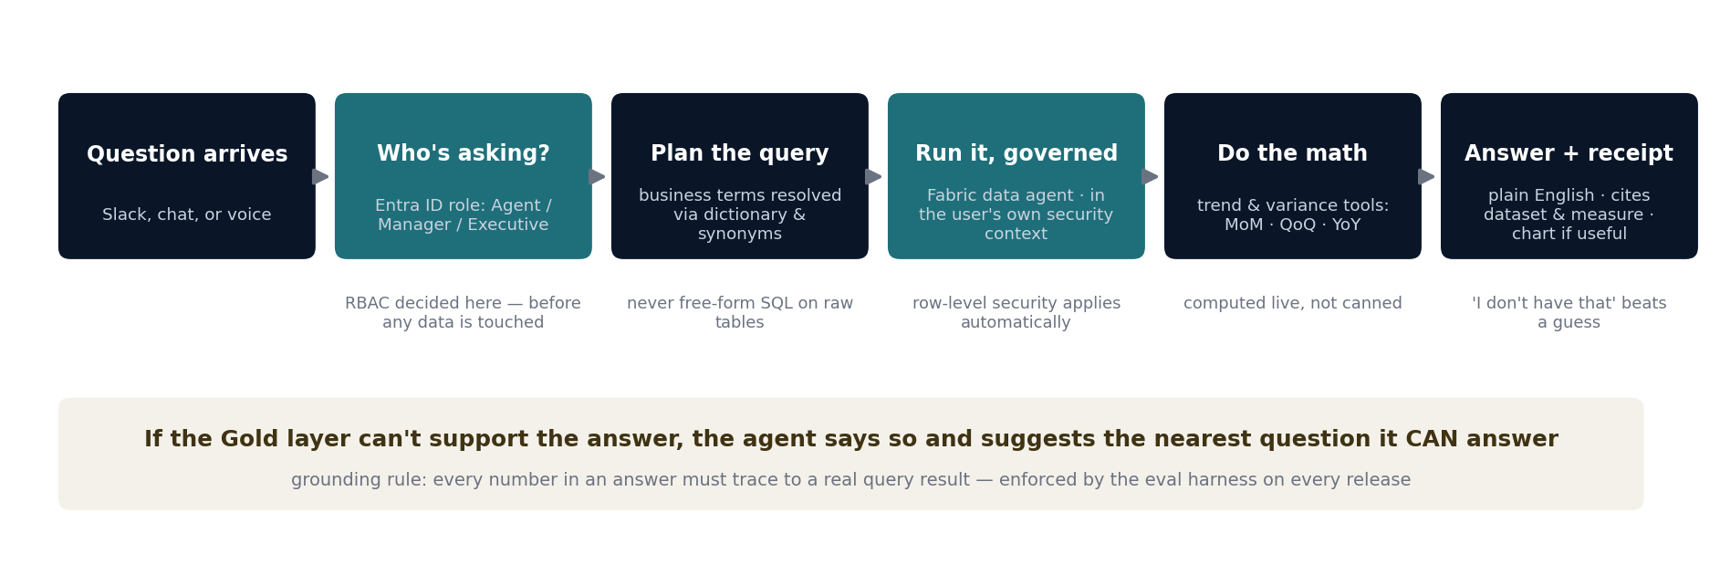
TECHNICAL ARCHITECTURE
How a question becomes a trustworthy answer
Six steps, every time — with the security decision made first, and a receipt at the end
Why answers will match your Power BI numbers
The agent only queries the semantic model — the same definitions your reports use. During Discovery we reverse-engineer your most-used reports and lock their measures in; QA then runs your 20–50 question bank against agent and report until they agree. That test is the gate into UAT.
6

Slide 7
TECHNICAL ARCHITECTURE
Trends, variance, and prediction — as reasoning, not reports
Three analytics faculties, one conversational surface
Trend & variance
The agent computes MoM / QoQ / YoY live from the Gold layer for whatever the user asks — any metric, any slice their role permits — and draws the trend automatically when a picture says it better. Nothing is pre-canned; new questions need no new build.
"How did first payment rate move this quarter versus last, by team?"
Predictive
Models trained on your own Gold history (agent performance, resolution and first-payment outcomes) are scored on schedule back into Gold tables. The agent reads those scores like any other data — and always labels a forecast as a forecast, with the confidence range stated.
"What does next month look like for deals signed on Team West?"
Individual & team views
The same question means different data at different tiers. An agent sees their own performance; a manager sees their team; an executive sees the business. That scoping is enforced by RBAC in the control plane — not by trusting the model to behave.
"Show me my numbers this month" — from an agent, a manager, an executive
7

Slide 8
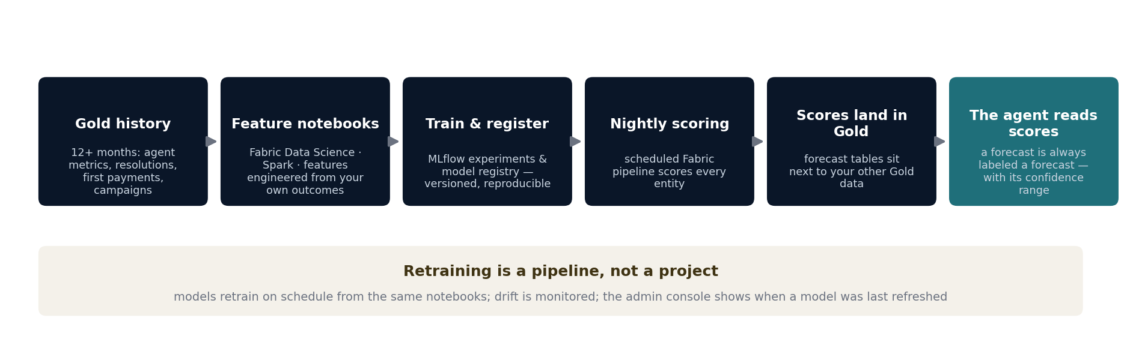
TECHNICAL ARCHITECTURE · HOW IT WORKS
How prediction works — a pipeline, not a promise
Your own Gold history in; labeled forecasts out; retraining on a schedule
What the first two models are
Model 1 forecasts agent performance and volume (deals signed, resolutions) by team and period. Model 2 scores resolution and first-payment likelihood at account level. Both train purely on Gold-layer history that's in scope today — no external data, as per the RFP. Additional models are a priced option once these two earn trust.
8

Slide 9
CLIENT QUESTION · CAN THE MODELS BE TRAINED INCORRECTLY?
Two kinds of models — and how each is kept from going wrong
Short answer: the language models are never trained on your data by anyone, and the two forecasting models we do train pass six checks before they touch a real answer
The language models (GPT-4o family)
The two forecasting models (built on your data)
We do not train these. Nobody does.
These we do train — under six controls:
They are used exactly as Microsoft ships them. Your data never changes them — so they cannot be “trained incorrectly” by this project, by us, or by your usage.
1 · Agreed data only
Trained only on Gold-layer history you sign off in Discovery — no external data, nothing unvetted.
2 · Tested on data it never saw
Part of the history is held back; the model must predict it correctly before it goes anywhere.
The real risk with a language model is different: it can word an answer from its general knowledge instead of your data. We remove that risk by design:
3 · Back-tested against reality
Its forecasts are checked against what actually happened in past months — accuracy shown to you.
Every number in an answer must come from a real query against your Gold layer — the model may explain results, never supply them
If the data can’t answer, the agent says so — it is not allowed to fill the gap from memory
The question bank replays on every release; if answers stop matching the Power BI baseline, the release is blocked
4 · A person approves every release
No model reaches production without a documented human review of its test results.
5 · Watched every month
Accuracy tracked in the admin console; drift triggers retraining, visibly.
6 · Every version on record, instant rollback
MLflow keeps each version with the exact data and code that built it — a bad model rolls back in minutes.
And a forecast is always labeled a forecast, with its confidence range — never presented as fact.
9
ARTIZENT · PROJECT ELEVATE

Slide 10
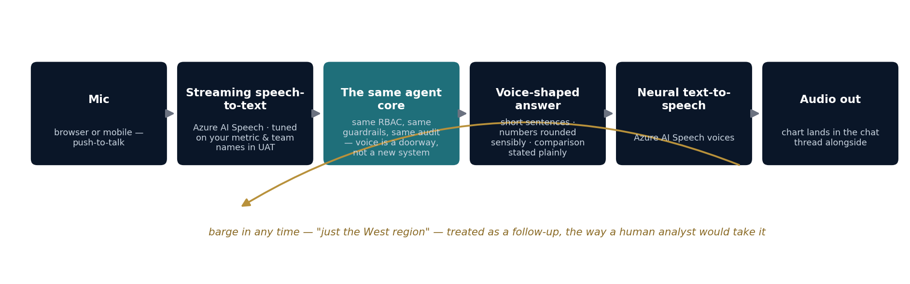
TECHNICAL ARCHITECTURE · HOW IT WORKS
Voice: a spoken conversation, not dictation
Voice in, voice out — the same governed agent core, heard instead of read
An honest note on voice
Voice ships in the web chat client and admin console in this engagement (assumption A6); telephony / IVR integration is a different class of build and isn't in the RFP scope. Spoken answers are held to a stricter brevity guardrail than text — nobody wants a paragraph read to them. Latency target: first spoken words within ~2 seconds of the user finishing.
10

Slide 11
CLIENT QUESTION · HOW DOES VOICE FIT INTO THE CURRENT SOLUTION?
Adding voice: two components in, nothing else changes
Voice is a new doorway into the solution you already have — not a second system
What gets added
What stays exactly the same
Azure AI Speech, speech-to-text — turns the spoken question into text, streaming, inside your Azure tenant
Azure AI Speech, text-to-speech — reads the answer back in a natural voice
A microphone button in the web chat and admin console — push to talk, tap to interrupt
A “spoken answer” format — shorter sentences, rounded numbers, the chart posted to the thread alongside
The agent — a spoken question and a typed question hit the same brain, same logic
Your data — no new data paths, no new copies; voice reads from the same governed Gold layer
Security — the speaker signs in the same way; their role limits what they hear, exactly as it limits what they read
The audit log — a spoken question is logged like a typed one, transcript included
How it rolls out, and what it costs to run
Text first, voice close behind. Text channels go live first (W5–8 in the build plan); the voice layer is added to the same clients in W9–13 and tuned during UAT on your real vocabulary — metric names, team names, product terms — so it hears “first payment rate” correctly the first time. Target: the answer starts speaking within about 2 seconds of the user finishing.
Running cost is small and metered: speech is pay-per-minute on your Azure bill (≈$63/month at our assumed 10% voice share; the exact figure is in the estimation workbook and shows live in the admin console). Phone-line / IVR voice is a different project and is not in this scope — said plainly so there is no surprise later.
11
ARTIZENT · PROJECT ELEVATE

Slide 12
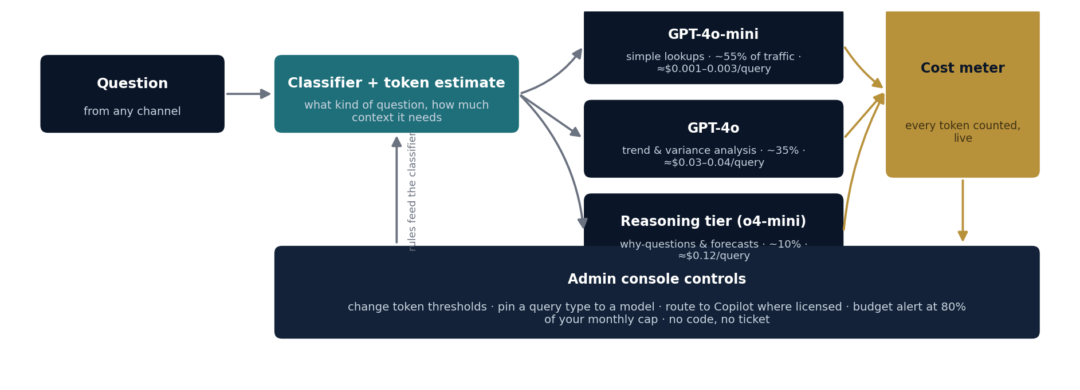
TECHNICAL ARCHITECTURE · HOW IT WORKS
The model router: every question earns its cost
Model-agnostic by design — the router chooses, your admins can override, the meter never sleeps
Blended at your stated 500 queries/day: ≈ $0.026–0.031 per query, ≈ $400–470/month including voice — full math and sensitivity in the estimation workbook. Consumption bills direct to your Azure tenant; we never mark it up.
12

Slide 13
TECHNICAL ARCHITECTURE
Where people meet the agent
Slack first — because the fastest adoption curve is the tool already open on every screen
Slack — the primary channel
Admin console — your operations team's cockpit
Ask in a DM or bring the agent into a channel — answers arrive in-thread, charts attached
Shared learning by design: when a manager asks a great question in a channel, the whole team sees the answer — and the question bank grows from real usage
Every user is identified through Slack SSO, so RBAC follows the person, not the channel
Sensitive (executive-tier) answers auto-route to DM even if asked in a channel — the agent never leaks a tier upward or sideways
Feedback buttons on every answer (right / wrong / unclear) feed the QA loop weekly
Spend by model, by day, by user tier — the token bill is never a surprise
Routing controls: change token thresholds, pin a query type to a model, or force Copilot — no code, no ticket
Full interaction log: every question, answer, citation, and guardrail event — searchable, exportable, retained per your policy
Guardrail tuning: review blocked queries, adjust scope rules, approve new synonyms into the dictionary
Health view: latency, answer-match rate vs baseline, adoption by tier
13

Slide 14
TECHNICAL ARCHITECTURE
The admin console: what your operations team sees and controls
Illustrative screen
ELEVATE · Admin Console
env: PROD · signed in: ops@bettercompanies · role: Admin
Overview
Spend, month to date
Queries today
Avg cost / query
Answer-match vs baseline
$438
512
$0.031
97.4%
Spend
of $600 cap · alert at 80%
target steady state 500/day
incl. voice · vs $0.026 model-only
question-bank replay, last release
Routing
Spend by model — this month
Routing controls
Guardrails
Token threshold — simple
≤ 5K tokens → GPT-4o-mini
Audit log
Token threshold — standard
5–15K tokens → GPT-4o
Health
Token threshold — complex
> 15K tokens → o4-mini
Pinned: certified PBI measures
→ Copilot (zero marginal token cost)
Budget alert
80% of monthly cap · ON
Live interaction log
TIME
TIER
QUESTION
MODEL
TOKENS
COST
GUARDRAIL
09:41
Manager
compare first payment rate QoQ across teams
GPT-4o
11,240
$0.036
—
09:40
Agent
what were my deals signed last week
4o-mini
3,870
$0.001
—
09:38
Agent
show me account balances for team east
—
—
—
PII blocked · logged
14

Slide 15
WHAT IT WILL LOOK LIKE · INTERFACE PREVIEW
A preview of the interface — and a live demo to follow
Design mock-ups, sized to the real build; a clickable prototype is ready for the Week-0 session
# ops-analytics · ELEVATE agent
VOICE · web chat client
Devon (Manager) · 9:41 AM
🎤
how did first payment rate move this quarter vs last, by team?
ELEVATE · APP
First payment rate is 84.2% this quarter, up 2.1 points from 82.1%. Team East improved most (+3.4 pts); Team North slipped 0.8 pts — the dip traces to week-2 staffing.
“How are deals looking this month for Team West?”
East 87.9%
West 84.6%
🔊 “Team West has signed two hundred and twelve deals — about six percent ahead of last month. Want the breakdown by agent?”
North 80.1%
Source: gold.resolutions · FirstPaymentRate by Team, Quarter
👍
👎
Show as chart
Ask a follow-up
Maria (Agent) · 9:44 AM (via DM — personal scope)
what were my deals signed last week?
You signed 14 deals last week — 3 above your 4-week average. Your resolution rate held at 61%. Source: gold.agent_metrics
Seeing it live
A clickable prototype of both interfaces is ready to walk through in the Week-0 prep session. From sprint 2 onward, the bi-weekly demos show the real agent answering real questions in your Dev workspace — not mock-ups.
Same question types, different scope per role — the RBAC slide in action. Feedback buttons feed the weekly tuning loop.
15
ARTIZENT · PROJECT ELEVATE

Slide 16
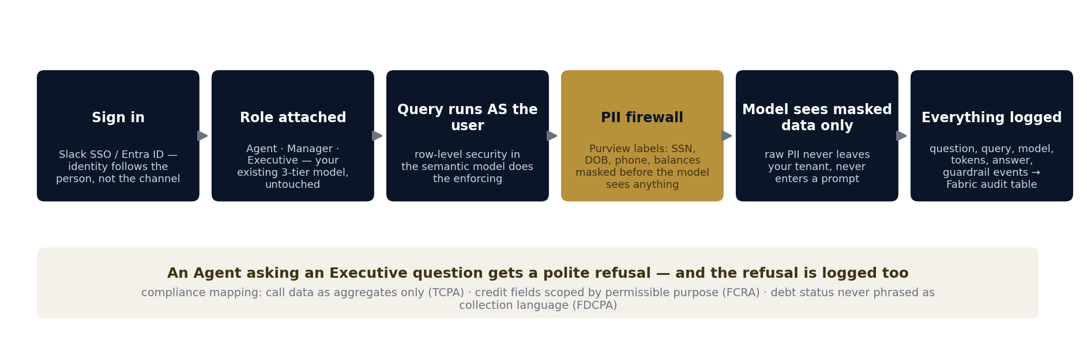
GOVERNANCE & COMPLIANCE · HOW IT WORKS
How every request stays inside the lines
Identity first, masking before the model, a log entry no matter what
The design principle
We never trust the model to behave — we make misbehavior structurally impossible. RBAC is enforced by the data platform, masking happens before a prompt exists, and the guardrails run in code we can test, not in instructions we hope the model follows.
16

Slide 17
GOVERNANCE & COMPLIANCE ·
One question, three tiers, three governed answers
Your existing Agent / Manager / Executive model, inherited — the same question returns only what each role may see
The same question from all three: “How are deals signed looking this month?”
AGENT
MANAGER
EXECUTIVE
Maria — call-center agent
Devon — Team East manager
Krish — leadership
RBAC ENFORCEMENT — THE SAME GATE FOR EVERY CHANNEL
Role comes from Entra ID at sign-in → the query runs AS that user → row-level security in the semantic model decides what data exists for them. The AI model is never trusted to filter — it only ever receives what the role already permits.
Your numbers: 14 deals signed · 61% resolution · first-payment rate 84%
Team East: 118 deals · agent-by-agent breakdown · QoQ trend by team
All teams & brands: 1,412 deals · variance drivers · next-month forecast
sees: own records only
sees: own team, aggregated + drill-down
sees: whole business, incl. forecasts
And when someone asks above their tier:
Maria (Agent): “Show me Team East’s numbers by agent” → “That view is available to managers. I can show you your own performance, or you can ask Devon.” — refused politely, suggested the right path, and logged to the audit table with user, question and rule applied.
17

Slide 18
GOVERNANCE & COMPLIANCE ·
Guardrails: four gates every answer must pass
Hallucination and out-of-scope access are blocked in code we can test — not in instructions we hope the model follows
Question in →
GATE 1 · Scope gate
GATE 2 · Grounded generation
GATE 3 · Answer validation
GATE 4 · Continuous evals
Is this answerable from the Gold layer, by this role? Out-of-scope topics (external data, ERP, other tiers) stop here.
The agent may only use numbers returned by a real, governed query. No query result = no number. Ever.
Before sending: every figure re-checked against the result set; citation of dataset + measure attached; forecasts labeled with confidence.
The 20–50 question bank replays automatically on every release; answer-match tracked; any drop blocks the deploy.
blocks out-of-scope access
blocks invented figures
blocks unsupported claims
blocks silent regression
→ Answer, with its receipt
When a gate fails, the user still gets a useful reply: “I can’t answer that from the data I’m allowed to use — the nearest question I can answer is your team’s resolution rate this quarter. Want that?” Every gate failure is logged with the rule that fired.
MAINTAINED, NOT INSTALLED — THE WEEKLY TUNING LOOP
1. Review blocked & low-scored queries
2. Update dictionary, synonyms & scope rules
3. Re-run the full eval suite
4. Release — only if answer-match holds
↺ repeats weekly through hypercare; monthly under optional managed support
18

Slide 19
GOVERNANCE & COMPLIANCE
PII: identified by Purview, masked in your tenant, excluded from every prompt
Raw PII never enters a prompt and never appears in a response: SSN, date of birth, phone numbers, account balances
1 · IDENTIFY
2 · MASK
3 · EXCLUDE
Microsoft Purview
In-tenant masking layer
Prompt firewall + response scan
Purview scans the Gold layer and labels sensitive columns; the D5 field map with your compliance team confirms the list. New columns inherit labels automatically.
Between Fabric and the agent, labeled fields are masked or dropped. Masking runs inside your Azure tenant — raw values never cross into the AI platform.
A firewall scans every prompt for PII patterns typed by users (“look up SSN 545…”) and every response before it’s sent. A hit blocks, redacts and logs.
A REAL RECORD, BEFORE AND AFTER
FIELD
IN THE GOLD LAYER (your tenant)
WHAT THE AI MODEL RECEIVES
Customer
Janet R. Alvarez
CUST-88214 (pseudonymous ID)
SSN
545-xx-xxxx (labeled: Confidential)
— excluded entirely
Date of birth
1981-03-22 (labeled: Confidential)
age band: 40–49 (only if a query needs it)
Phone
(949) 555-0142 (labeled: Confidential)
— excluded entirely
Account balance
$18,420.55 (labeled: Restricted)
balance band by tier; exact only where role permits
Resolution outcome
Settled · first payment made
Settled · first payment made — not PII, flows normally
Fictitious record for illustration. The exact mask-vs-band-vs-exclude rule per field is signed by your compliance team at the Discovery gate (task D5).
19

Slide 20
GOVERNANCE & COMPLIANCE ·
The audit trail: what is captured, where it lives, how long it stays
Every AI interaction produces one immutable record — in your tenant, in a table your compliance team can query like any other
WHAT IS CAPTURED — one record per interaction
WHERE IT LIVES
interaction_id
a91f…4c · 2026-07-15 09:41:07 PT
A governed, append-only Delta table in your Fabric tenant
· cataloged in Purview like every other asset
· RBAC’d to compliance & admins — the agent itself cannot read or edit it
· surfaced in the admin console; exportable for examiners on request
· never leaves your tenant — no vendor copy exists
user / tier / channel
devon.k · Manager · Slack
question (verbatim)
“compare first payment rate QoQ across teams”
resolved query
semantic model · FirstPaymentRate by Team, Quarter
datasets touched
gold.resolutions · gold.teams
rbac context
row-level: teams where manager = devon.k
HOW LONG IT STAYS
model / tokens / cost
GPT-4o · 11,240 tok · $0.036
hot · queryable — months 0–18
archive — to 24 mo
24 months by default (assumption A8) — a placeholder until your retention policy is confirmed at the Discovery gate.
Configurable per policy · legal hold supported · deletion only via governed policy job, itself logged.
answer + citations
stored in full, incl. chart spec
guardrail events
none (PII scan: clean · grounding: 4/4 figures traced)
user feedback
👍 · fed to weekly tuning loop
20

Slide 21
GOVERNANCE & COMPLIANCE
TCPA, FCRA, FDCPA: designed in, not bolted on
For each regulation: what it restricts, the design rule the agent lives by, and the component that enforces it
TCPA
FCRA
FDCPA
Telephone Consumer Protection Act
Fair Credit Reporting Act
Fair Debt Collection Practices Act
WHAT IT RESTRICTS
WHAT IT RESTRICTS
WHAT IT RESTRICTS
Restricts how call data and customer contact records are used.
Governs handling of consumer credit and financial data — permissible purpose matters.
Restricts how debt-related information is used and surfaced.
THE DESIGN RULE
THE DESIGN RULE
THE DESIGN RULE
The agent surfaces call data as aggregates and outcomes only — never as dialable contact lists, phone numbers, or anything that could seed an outbound campaign. And no AI outbound voice, anywhere.
Credit-derived attributes are scoped by tier to roles with a permissible purpose; excluded from the Agent tier entirely. The agent never produces adverse-action-style statements about a consumer.
Debt status is presented as neutral account facts for analytics — never phrased as collection language, scripts, or anything that could constitute a collection communication.
Enforced by: scope gate (Gate 1) · PII exclusion of phone fields · persona measure packs
Enforced by: RBAC row/column rules · answer-composer language rules · audit trail per query
Enforced by: approved-language library in the composer · automated language QA on outputs
Who signs it off, and how it stays true: your compliance SMEs sign the guardrail ruleset at the Discovery gate (D5); compliance test cases live inside the eval suite and replay on every release; any change to these rules goes through the same gate it was born in.
21

Slide 22
CLIENT QUESTION · SECURITY OF DATA
Your data: inside your four walls, start to finish
Everything lives in Better Companies’ Azure tenant — and if you switched us off tomorrow, everything stays with you
WALL 1 — Your Azure tenant
What Microsoft guarantees, in writing
Data, semantic models, AI workloads and logs all run here — no copy exists on Artizent’s side, or anyone else’s.
Azure OpenAI: your prompts and answers are NOT used to train the models
Not shared with other customers, and not shared with OpenAI
Encrypted in transit and at rest, in your tenant’s region
This is why we chose Microsoft’s business AI, not consumer AI tools
WALL 2 — Sign-in & roles
Entra ID for every user; Artizent engineers work under YOUR access control — revocable by your team any time.
WALL 3 — PII masking
SSNs, birth dates, phone numbers and balances are masked in your tenant before any AI model sees anything.
YOUR GOLD DATA
queried in your tenant,
under the asking user’s role
And it’s all on the record
Every AI interaction — who asked, what data was touched, which model answered — is logged to a table in your tenant that your compliance team can query without asking us.
22
ARTIZENT · PROJECT ELEVATE

Slide 23
CLIENT QUESTION · SELF-HEALING
When something breaks, it fixes itself first
For each failure: how it’s caught, what happens automatically, and when a person gets called
WHAT FAILS
HOW IT’S CAUGHT
WHAT HEALS AUTOMATICALLY
WHEN A PERSON IS CALLED
An AI model is slow or down
Health probe on every call
The router re-sends the question to the next model on the list — the user still gets an answer, a touch slower
If all models fail for 5 minutes → on-call paged
The nightly forecast job fails
Pipeline monitor
Automatic retry with back-off; yesterday’s scores keep serving, clearly dated as yesterday’s
Second failure → data engineer alerted before business hours
Answer quality drops after a change
Question-bank replay on every release
The release is blocked and the previous version keeps running — rollback is automatic, not a decision
Engineer reviews the failing answers same day
Forecast accuracy drifts over time
Monthly drift monitor in the admin console
Retraining triggers on schedule; the new version is promoted only if it beats the old one on held-back data
A person approves every promotion (training control #4)
A spike in blocked or PII-flagged queries
Guardrail counters with alert thresholds
Nothing degrades — the guardrails simply keep holding; the pattern is flagged for review
Compliance notified the same day, with the log entries
Design rule: degrade politely, never silently. The user always gets an answer or an honest “try again shortly” — and every self-heal writes a log entry, so nothing fixes itself invisibly.
23
ARTIZENT · PROJECT ELEVATE

Slide 24
DELIVERY PLAN & MILESTONES ·
Sixteen weeks to production
Seven workstreams · five signed gates · weekly steering · a demo every two weeks
DISCOVERY
BUILD
UAT & HARDENING
PROD
HYPERCARE
W1
W2
W3
W4
W5
W6
W7
W8
W9
W10
W11
W12
W13
W14
W15
W16
+1
+2
Semantic gap fixes
Data & semantic foundation
Dictionary Hardening
Dictionary hardening
QA · overlaps Build (W8-13)
Agent core & analytics
Query planner & answer composer
Model router + cost meter
Trend / variance tools
Predictive ML
Train models 1 & 2 (MLflow)
Nightly scoring to Gold
Channels
Slack app + SSO
Voice (STT / TTS)
Admin console
Governance & compliance
RBAC & PII field map
Guardrails + eval harness
sign-off
QA & validation
Baseline vs Power BI (question bank)
Regression
PII red-team · voice · load
UAT, adoption & go-live
3-tier UAT
Go-live
Hypercare same-day
Runbooks + KT
Gates & cadence
G1 · scope signed
G2 · agent live in Dev
G3 · PBI baseline
G4 · UAT sign-off
G5 · go-live
24

Slide 25
DELIVERY PLAN & MILESTONES
What you sign for at the end of each phase
Deliverables Per Phase
DISCOVERY
BUILD
QA
UAT & HARDENING
PRODUCTION
W1–2
W3–11
W8–13
W12–15
W16 +2
DELIVERABLES
DELIVERABLES
DELIVERABLES
DELIVERABLES
DELIVERABLES
Hardened Gold data dictionary
Dataset grouping (facts & dims)
Baseline pack: top-20 reports + semantic measures, reverse-engineered
Tagged 20–50 question bank
RBAC & PII field map, compliance-signed
Architecture blueprint + SOW acceptance criteria
Working agent in Dev: NLQ + trend / variance
2 predictive models scored to Gold
Slack app · chat client · voice · admin console
Model router live, cost meter running
Guardrails + automated eval harness
A recorded demo every two weeks
Baseline validation report: question bank vs Power BI, answer by answer
What-if & PII red-team results
Voice test report (accuracy, latency)
Load & cost test vs 500 queries/day
Regression suite — handed to your team
UAT sign-off from all three tiers
Guardrail ruleset tuned on real user phrasing
Admin, routing & incident runbooks
Knowledge transfer sessions delivered
Go-live readiness checklist, jointly signed
Slack + admin console live in production
Hypercare: 2 weeks, same-day response
Hypercare log & closure report
Formal handover — your team runs it
G1 · “Shared understanding of Gold layer scope — no surprises entering Build”
G2 · “Working agent answering real business questions — tangible progress every sprint”
G3 · “Agent answers match the business baseline before UAT begins”
G4 · “Sign-off from real users across all three roles — adoption risk retired before go-live”
G5 · “Live, production-grade AI capability delivered to end users”
25

Slide 26
DELIVERY PLAN & MILESTONES
Why QA rides alongside Build — and what it buys you
Four weeks of parallel running is the buffer that protects the Week-16 go-live
W4
W5
W6
W7
W8
W9
W10
W11
W12
W13
W14
W15
W16
W17
W18
W19
W20
A sequential plan
(what we're avoiding)
Build
QA
UAT
go-live ~W20 · defects found after the builders have moved on
This plan
Build
QA — in parallel
UAT
go-live W16 · four weeks earlier, with five quality checkpoints already passed
The QE joins Week 4, not Week 12
Quality is measured five times before UAT
One board, one stand-up, one team
While code is being written, the quality engineer is building the automated harness beside it — so testing starts the day the first feature lands, not after the last one.
Every two-week sprint ends with a question-bank replay against the Power BI baseline. By the QA gate, answer-match has been scored five times — UAT confirms, it doesn't discover.
Build and QA share the same daily stand-up. A failed baseline test on Tuesday is sprint work on Wednesday — fixed by the engineer who wrote it, not queued as a change request.
26

Slide 27
DELIVERY PLAN & MILESTONES
The rhythm of the engagement
Exactly the cadence your §5.2 requires — plus who sits in each room, and how a blocker escalates
BC sponsors
BC SMEs / engineers
Engagement lead
Delivery team
Daily stand-up
Yesterday, today, blockers. Your engineers welcome any day.
15 min · W4–13 (Build & QA) · 8:30 AM PT, async option
Bi-weekly sprint demo
Working software, live in the Dev workspace — not slides. Recorded for anyone who missed it.
45 min · every 2 weeks through Build
Weekly steering
Both executive sponsors. Status, risks, decisions needed, spend vs plan — one page, no surprises.
60 min · every week, W1–16
Phase gates × 5
Formal review against the §5.1 outcome; written sign-off before the next phase starts. SOW acceptance criteria signed before any work begins.
At each phase boundary
Escalation: any blocker unresolved in 4 hours → engagement lead · sponsor-level the same day · every decision logged in steering minutes
● attends ○ optional / as needed
27

Slide 28
RISKS & DEPENDENCIES
Risks, dependencies, and what we'll do about each
Named honestly now, plotted by likelihood and impact, each with a mitigation and an owner
Gold dictionary less mature than described (A2)
Joint
R1
R4
Week-1 readiness rubric; a rebuild surfaces at the Discovery gate with options — before Build pricing is at risk.
Question bank arrives late or thin (A4)
BC
R2
R1
We seed a starter bank from report usage logs in parallel — QA is never blocked waiting.
IMPACT ↑
Semantic model gaps found in reverse engineering (A12)
Artizent
R6
R3
Fixed in the semantic layer within our estimate; Gold-pipeline changes flagged at the gate as separate scope.
R3
SME availability slips (A9: 6–8 hrs/wk)
BC
R4
Sessions booked two weeks ahead; slippage moves the affected gate week-for-week — stated plainly in the SOW.
R5
R2
Slack approval / Azure OpenAI tenant setup delays (A5, A11)
BC
R5
Week-1 checklist provided; chat client & voice don't depend on Slack, so the critical path never waits.
LIKELIHOOD →
Adoption — the tool works but nobody asks
Joint
R6
Slack-first channel, tier champions in UAT, shared-channel learning; adoption on the steering dashboard from W12.
Dependency owner: BC = Better Companies provides · Joint = shared · Artizent = ours to absorb
28

Slide 29
TEAM COMPOSITION
The team composition
ROLE
WEEKS (FULL-TIME)
WHAT THEY OWN
Delivery Leader / Scrum Master (engagement lead)
W1–16
Single point of contact; runs steering & stand-ups; every deliverable reviewed before it reaches your workspace
Solution Architect · 10–12 yrs
W1–16
Agent core, routing, guardrails design; Responsible AI lead
Fabric / Data Architect · 10–12 yrs
W1–10
Semantic binding, Fabric data agent, Gold-layer interfaces — continuity from the AS-IS review; architecture review through W16 gates
AI Engineer #1 · 4–6 yrs
W3–16
Query planner, composer, trend tools, Slack app
AI Engineer #2 · 4–6 yrs
W3–16
Admin console, voice channel, chat client, router
Data Engineer (ML) · 5–7 yrs
W3–16
Feature pipelines, predictive models, MLflow, scoring to Gold
PowerBI Developer · 4–6 yrs
W3–16
Senior Quality Engineer · 5–7 yrs
W3–16
Baseline validation harness, what-if testing, PII red-team — joins Week 4, not Week 12
Working rhythm: daily overlap window 8:00–9:30 AM PT · stand-up 8:30 AM PT (async option) · everything logged in the sprint board you can see any time · any blocker unresolved in 4 hours escalates to the engagement lead. Named individuals and bios in the appendix; references on request.
29

Slide 30
CLIENT QUESTION · PREREQUISITES & LICENSING
Before Week 1: what you need — and what you don’t
Mostly settings, not purchases. And no — you do not need Claude enterprise licenses.
You already have
(nothing to buy)
Enable before Week 1
(settings — pay-per-use, no new licenses)
Not needed
Microsoft Fabric capacity + OneLake — running today
Power BI and the semantic models
Microsoft Purview
Entra ID for sign-in and roles
Copilot licenses — used where they exist; this project needs no new seats
Slack workspace
Azure OpenAI resource in your tenant — one-time Microsoft access approval; usage billed per use on your Azure bill
Azure AI Speech resource (for voice) — same model: enable once, pay per minute
Dev / QA / Prod workspaces and team access — your §4.1 commitment
Slack app approval request submitted — typical 2-week review; not on the critical path
Claude / Anthropic enterprise licenses — the whole solution runs on Azure OpenAI inside your Microsoft stack. (The router is model-agnostic, so other providers could be added later through Azure AI Foundry, pay-per-use — but nothing in this scope requires it.)
Per-user AI licenses — usage is metered by consumption, not by seat
A bigger Fabric SKU — not assumed; we measure AI headroom on your current capacity in Week 1 and flag it only if the numbers say so
Everything above is a line on the Week-0 checklist we bring to the prep session — walked through together, owner named per item.
30
ARTIZENT · PROJECT ELEVATE

Slide 31
COMMERCIALS
Commercials
Milestones
Description
Date
Price (USD)
M1
Conduct discovery workshops, assess the Gold layer, validate the semantic model, refine the data dictionary, reverse engineer existing Power BI reports, and finalize the AI solution architecture and implementation roadmap.
Week 4
$46,736
M2
Build the core AI assistant with conversational NLQ capabilities while implementing governance, security, RBAC, responsible AI guardrails, and multi-channel interfaces.
Week 8
$70,104
M3
Develop trend analysis, predictive insights, persona-based analytics, and implement model management with intelligent routing and cost optimization.
Week 12
$70,104
M4
Validate the solution against the predefined question bank, complete UAT, train business users, and deploy the AI assistant to production with hypercare support.
Week 16
$ 46,736
Total
-
$233,680
Terms & Conditions:
The quoted price for the defined scope is in USD, and the project will be executed in a Fixed Bid Mode.
The cost estimates are based on the current understanding of the scope. Artizent will re-evaluate the effort and provide a revised estimate in case of scope or requirement changes.
The proposal is valid for 60 days from the date of proposal submission.
The commercials exclude any third-party/tool licensing costs.
AI tools will be leveraged for test case generation.
All AI tool licensing costs / subscription costs / token costs for the project will be provided and managed by Better Companies.
31

Slide 32
CASE STUDY · INSURANCE
Natural-language query over a contact-centre data estate, no SQL needed
THE CHALLENGE
NLQ
Business users needed plain-language access to data spread across many fact and dimension tables and several systems, with visibility into the generated SQL and no lock-in to a single vendor's ecosystem.
plain-language query, no SQL
Multi-source
HOW ARTIZENT DELIVERED
› Built a glossary, taxonomy, and knowledge graph over the contact-centre database.
› Enabled natural-language queries across related fact and dimension tables, with the generated SQL exposed.
› Designed a decoupled semantic layer that runs across SQL Server, Oracle, Databricks, and Microsoft Fabric.
runs across four database platforms
Knowledge graph
glossary, taxonomy, ontology
Business impact: Business users query governed data in plain language across systems, with transparent SQL and no vendor lock-in, validated through a proof of concept ahead of full rollout.
32

Slide 33
CASE STUDY · AUTOMOTIVE
Support ticket triage in seconds for an automotive data provider
THE CHALLENGE
Seconds
Support teams read every ticket to set priority, rewrote answers from scratch, and had no structured way to reuse past resolutions.
to triage every ticket
75%
HOW ARTIZENT DELIVERED
› Classified every ticket by priority, category, and issue automatically.
› Surfaced account context and the top similar past cases by semantic search.
› Drafted recommended responses behind a human review gate.
auto-resolution confidence
Auto
priority on every ticket
Business impact: Tickets are triaged and enriched before a human touches them, with past resolutions surfaced at the point of need.
33

Slide 34
CASE STUDY · HEALTHCARE
Proposal draft time cut 40-60% for a clinical guidelines platform
THE CHALLENGE
40-60%
Sales teams drafted proposals by hand from static templates, with no content library, no audit trail, and manual pricing across multi-year hospital contracts.
less proposal draft time
100%
HOW ARTIZENT DELIVERED
› Built four agents that carry proposals from CRM to customer-ready.
› Grounded every draft in approved clinical language and brand rules.
› Enforced human review gates with a full version audit trail.
version audit trail coverage
4
agents, CRM to customer-ready
Business impact: Reps get consistent, compliant, customer-ready proposals without manual assembly.
34

Slide 35
CASE STUDY · INSURANCE
Query performance from hours to under five seconds
THE CHALLENGE
< 5 sec
Manual policy and claims reporting across multiple systems caused slow analytics, high maintenance, and limited business visibility.
queries, down from hours
50%
HOW ARTIZENT DELIVERED
› Built a unified Microsoft Fabric platform.
› Automated data integration across source systems.
› Centralized models into one enterprise reporting layer.
less maintenance effort
1
source of truth, policy and claims
Business impact: Underwriting and claims decisions accelerate on a single, trusted source of truth.
35

Slide 36
APPENDIX
Your questions, answered in engineering detail
1 · How will voice be integrated into the solution?
2 · Can the models be trained incorrectly — and how do we prevent it?
3 · How is our data secured, inside our four walls?
4 · How does the solution heal itself when something fails?
5 · What are the prerequisites — and which licenses are (not) needed?
Full engineering detail, latency budgets and failure catalogues: ELEVATE — Client Questions, Detailed Technical Responses (companion document).

Slide 37
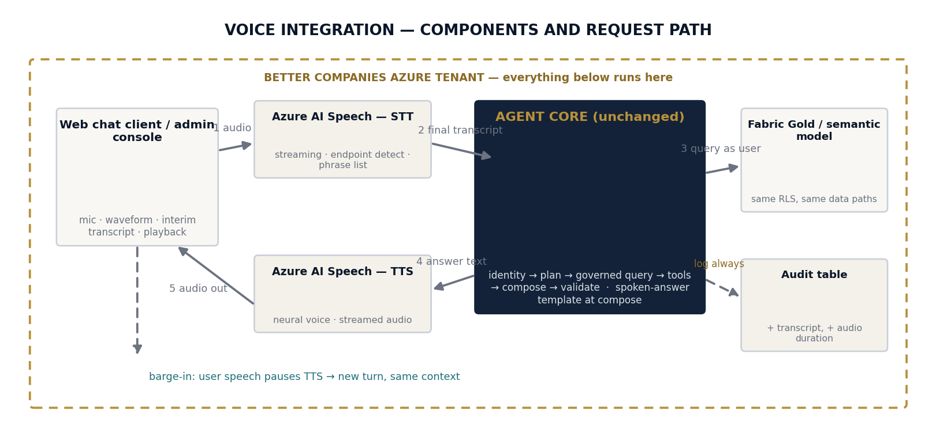
CLIENT Q&A · QUESTION 1 · VOICE
Voice: two components in, the same governed core
“How will Voice be integrated into our solution? Right now it incorporates Data and Text.”
Speech-to-text on the way in, text-to-speech on the way out — wrapped around the agent core that already serves data and text. Identity precedes audio, so RBAC, PII masking and audit apply to a spoken question automatically. Target ~2s to first spoken words; telephony/IVR explicitly out of scope (A6).
37
ARTIZENT · PROJECT ELEVATE

Slide 38
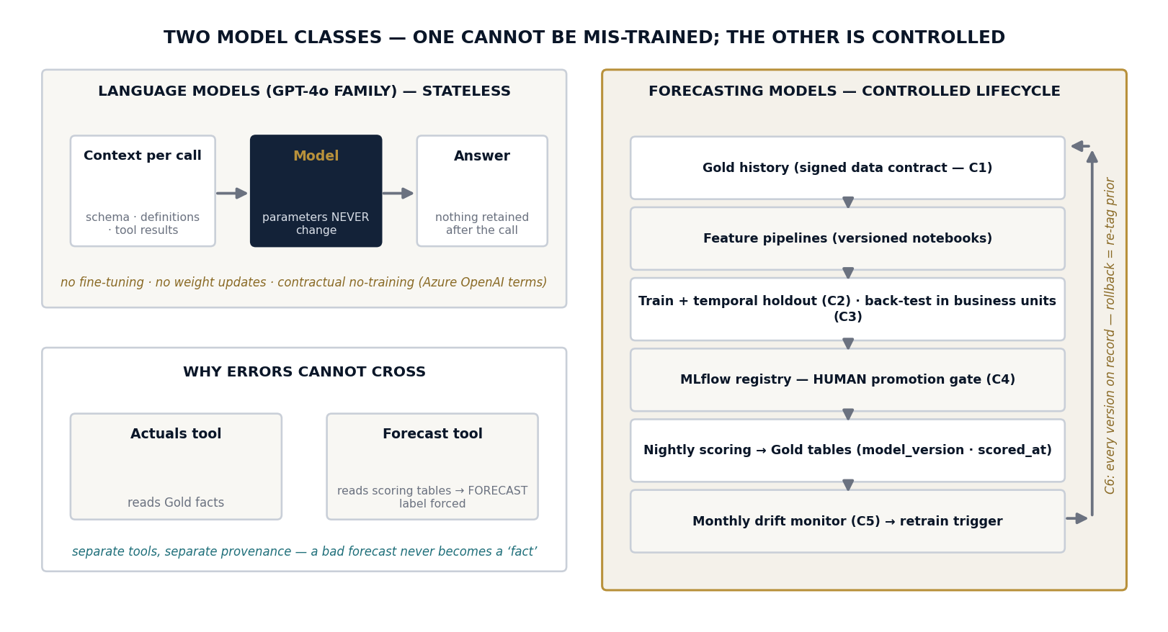
CLIENT Q&A · QUESTION 2 · MODEL TRAINING
The models cannot be mis-trained — here is why
“Can the models be trained incorrectly? How do we prevent that?”
The language models are never trained on your data by anyone — parameters never change; only per-request context does, and grounding removes the answer-from-memory risk. The two forecasting models we do train pass six controls: agreed data, temporal holdout, back-testing in business units, a human promotion gate, monthly drift watch, and instant versioned rollback.
38
ARTIZENT · PROJECT ELEVATE

Slide 39
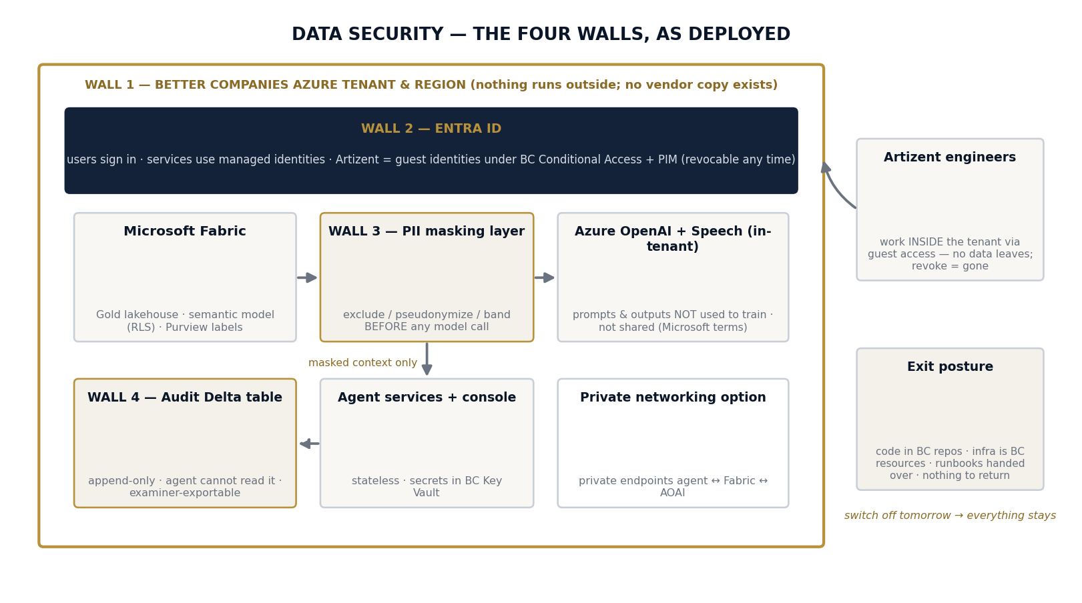
CLIENT Q&A · QUESTION 3 · SECURITY OF DATA
Inside your four walls, start to finish
“Ensuring ALL our data ALWAYS stays within our four walls and is not used to train others outside.”
Everything runs in your Azure tenant — data, AI, logs, code; no vendor copy exists. Microsoft's Azure OpenAI terms state your prompts and outputs are not used to train models and are not shared. Artizent works inside your tenant under your revocable access. Switch us off tomorrow: everything stays.
39
ARTIZENT · PROJECT ELEVATE

Slide 40
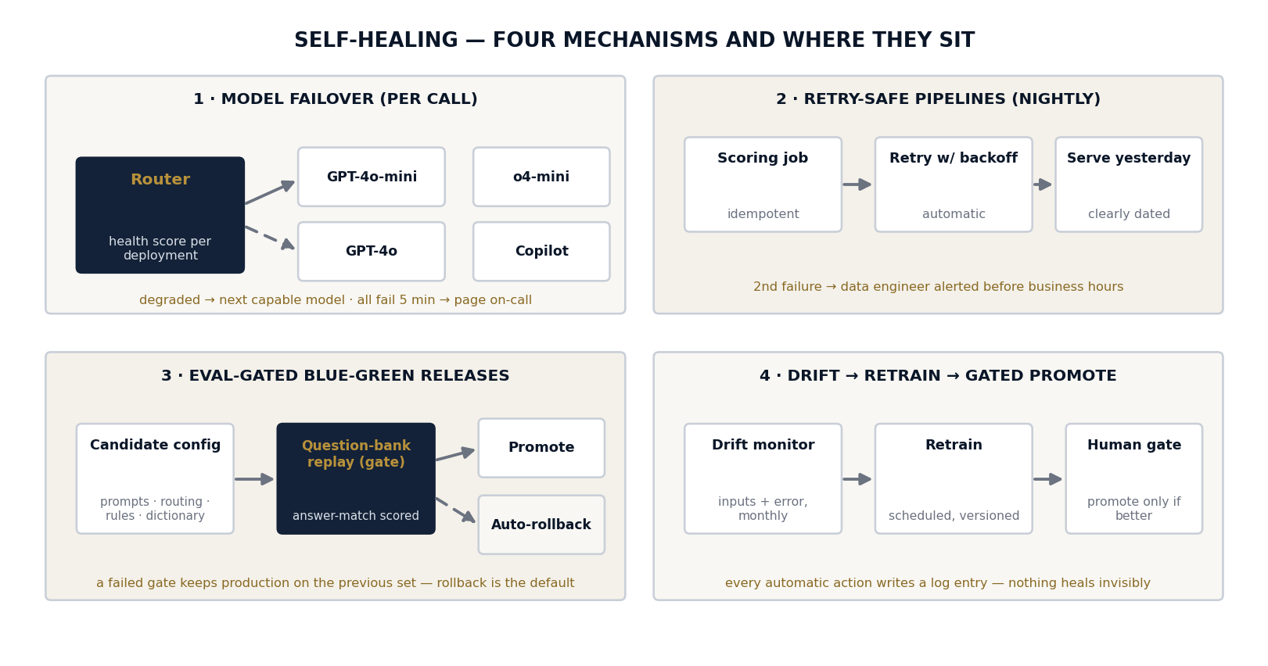
CLIENT Q&A · QUESTION 4 · SELF-HEALING
When something breaks, it fixes itself first
“Self-healing — how does the solution recover on its own?”
Four testable mechanisms: health-probed model failover, retry-safe pipelines that keep serving clearly-dated data, eval-gated releases where rollback is the default, and drift-triggered retraining behind a human gate. Design rule: degrade politely, never silently — every self-heal writes a log entry.
40
ARTIZENT · PROJECT ELEVATE

Slide 41
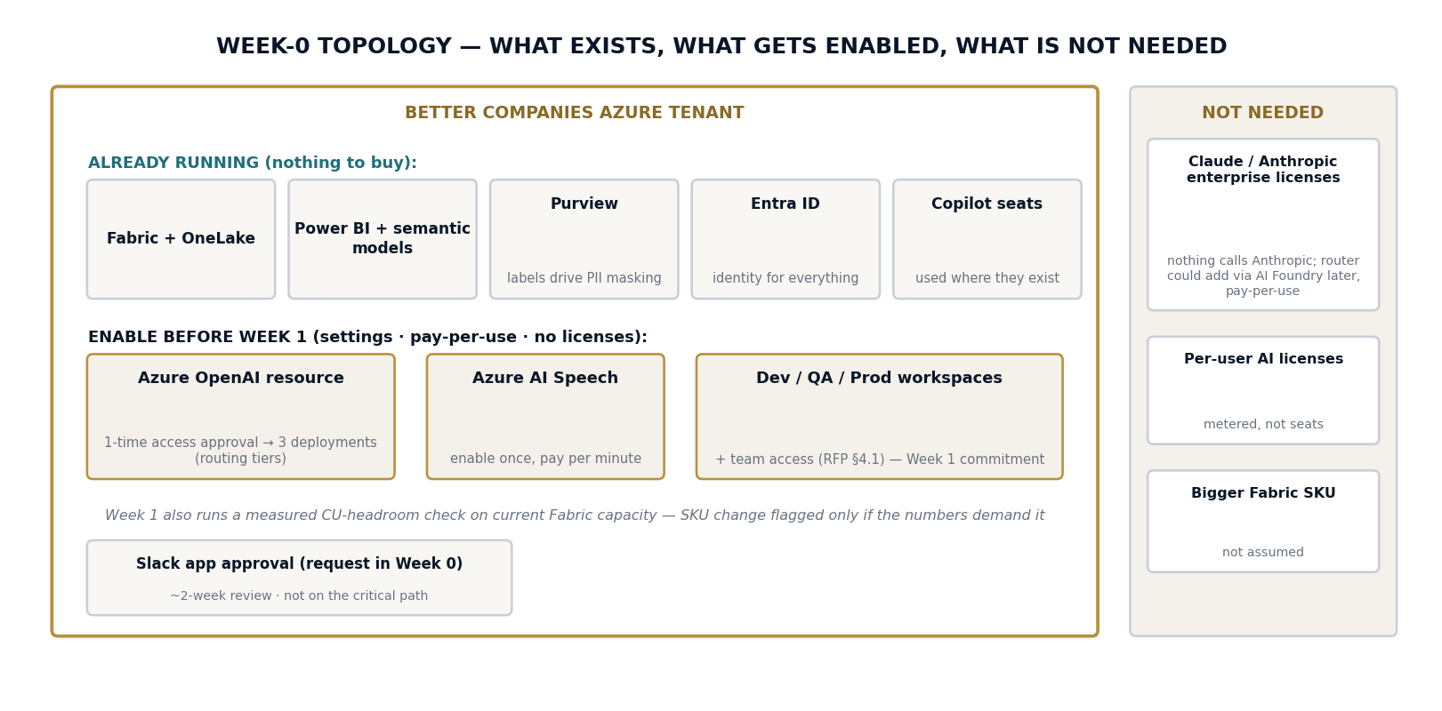
CLIENT Q&A · QUESTION 5 · PREREQUISITES & LICENSING
Mostly settings, not purchases — and no Claude licenses
“What prerequisites are needed? Do we need licenses, given Fabric and Copilot? Claude enterprise licenses too?”
Enable two pay-per-use resources before Week 1 (Azure OpenAI, Azure AI Speech), provision the three workspaces, submit the Slack app request. No Claude/Anthropic licenses — nothing in the architecture calls Anthropic (the model-agnostic router could add it later via AI Foundry if ever wanted). No per-seat AI licenses; no assumed Fabric SKU change.
41
ARTIZENT · PROJECT ELEVATE

Slide 42
Thank You
Next steps: A Statement of Work with defined acceptance criteria.
Artizent · Data & AI Practice · Microsoft Fabric Featured Partner

